Slide 1
Project Review-1
Batch no-1
ONLINE SHOPPING SYSTEM
Presented by
K.Madhulika (25B11AI552)
K.Joshitha (25B11AI430)
S.Rhoda (25B11AI493)
A.Sri Victoria (25B11AIB42)
S.V.D Mounika (26B21AI103)
Academic Year: 2026-2027
Under esteemed guidance of
Dr P KishoreKumar
Associate Professor
Department of AIML

Slide 2
Outline
Introduction
Problem Statement
Objectives
System Scope
Entities and Attributes
Relationships and Cardinality
Relational Database Schema
ER Diagram
Team Responsibilities
Conclusion

Slide 3
Introduction
Online shopping allows customers to purchase products through
a digital platform.
The system stores customer, product, order, payment,
and delivery information.
A database helps organize shopping information efficiently.
The project focuses on database design for Review-I.

Slide 4
Problem statement and Objectives
Problem Statement:
The Online Shopping System helps customers buy products from anywhere. It provides easy product search,online payment, and order tracking.
Objectives:
To allow users to shop online easily.
To display products with details.
To manage orders and payments.
To keep customer information secure.
To reduce shopping time.

Slide 5
System Scope
Customer Management
Customer details and accounts
Product Management
Product details and prices
Order Management
Customer order records
Payment Management
Payment information
Delivery Management
Order delivery details
Category Management
Product categories

Slide 6
Entities and their attributes
Entity | Attributes
Customer | Customer_ID, Name, Email, Phone, Address
Product | Product_ID, Product_Name, Price, Stock
Category | Category_ID, Category_Name
Order | Order_ID, Order_Date, Total_Amount
Payment | Payment_ID, Payment_Method, Payment_Status
Delivery | Delivery_ID, Delivery_Date, Delivery_Status
Order_Item | Order_Item_ID (PK), Order_ID (FK), Product_ID (FK), Quantity, Price
Cart | Cart_ID (PK), Customer_ID (FK), Created_Date, Total_Items
Review | Review_ID (PK), Customer_ID (FK), Product_ID (FK), Rating, Comment
Seller | Seller_ID (PK), Seller_Name, Email, Phone, Address

Slide 7
E-R Diagram Design
No. | Entity 1 | Relationship | Entity 2 | Cardinality
1 | Customer | Places | Order | One-to-Many
2 | Order | Contains | Order_Item | One-to-Many
3 | Product | Included in | Order_Item | One-to-Many
4 | Product | Belongs to | Category | Many-to-One
5 | Order | Has | Payment | One-to-One
6 | Order | Has | Delivery | One-to-One
7 | Customer | Has | Cart | One-to-One
8 | Customer | Writes | Review | One-to-Many
9 | Product | Receives | Review | One-to-Many
10 | Seller | Sells | Product | One-to-Many

Slide 8
Keys
NO | Entity | Attribute | Key (Primary/Foreign key)
1 | Customer | Customer_ID | Primary Key
2 | Product | Product_ID | Primary Key
3 | Category | Category_ID | Primary Key
4 | Order | Order_ID | Primary Key
5 | Payment | Payment_ID | Primary Key
6 | Delivery | Delivery_ID | Primary Key
7 | Order_Item | Order_Item_ID | Primary Key
8 | Cart | Cart_ID | Primary Key
9 | Review | Review_ID | Primary Key
10 | Seller | Seller_ID | Primary Key

Slide 9
E-R Diagram (Generate E-R diagram in https://app.diagrams.net/)
Draw the following entities and relationships in draw.io
Customer → places → Order
Order → contains → Product
Product → belongs to → Category
Order → has → Payment
Order → has → Delivery
Relationship | Cardinality | Explanation
Customer → Order | 1 : M | One customer can place many orders, but each order belongs to one customer.
Order → Product | M : M | One order can contain many products, and one product can be included in many orders.
Product → Category | M : 1 | Many products can belong to one category.
Order → Payment | 1 : 1 | One order has one payment, and one payment is associated with one order.
Order → Delivery | 1 : 1 | One order has one delivery, and one delivery is associated with one order.

Slide 10
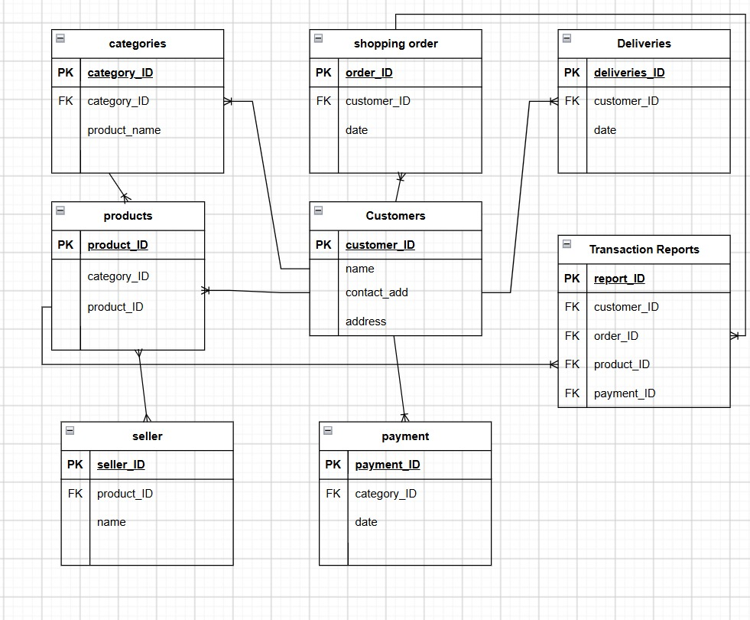

Slide 11
CONCLUSION
The Online Shopping System manages shopping data efficiently.
It stores customer, product, order, payment, and delivery information.
DBMS helps organize and manage the data.
Primary and foreign keys help connect the tables.
The system makes data searching and updating easier.
Overall, it provides a simple and efficient database system for online shopping.

Slide 12


